Slide 1
Daily Review
Describing and Drawing Forces
When describing forces, you need to:
Draw a diagram with labelled force arrows.
Remember: friction will resist movement!
Do the maths
Add the forces going in the same direction
Subtract the forces going in opposite directions
Describe the net force
Balanced (there is no net force)
Unbalanced (state the net force and its direction)
Yaz and Zach are sledding down a hill. The Earth is pulling them and their sled down the hill with 1500 N of force. There are 180 N of friction between the sled and the ground, and 30 N of friction between the air and the riders.
F_{friction}
180 N
1.
2.
3.
1500 – (180 + 30)
= 1500 – 210
= 1290
The net force is 1290 N down the hill.
F_{air}
30 N
F_{gravity}
1500 N

Slide 2
Daily Review
Describing and Drawing Forces
When describing forces, you need to:
Draw a diagram with labelled force arrows.
Remember: friction will resist movement!
Do the maths
Add the forces going in the same direction
Subtract the forces going in opposite directions
Describe the net force
Balanced (there is no net force)
Unbalanced (state the net force and its direction)
A helium-filled balloon has been let go and is floating through the air. Its buoyancy gives it an upwards force of 5 N. The Earth is pulling it down with 0.5 N of force, and there is 1 N of friction between it and the air.
1.
2.
3.

Slide 3
Daily Review
Natasha and Owen are playing tug-of-war. Natasha is pulling with 200 N and there are 350 N of friction between her and the ground. Owen is pulling with 280 N and there are 290 N of friction between him and the ground.
(Hint: all of the friction with the ground is transferred to the rope.)
Describing and Drawing Forces
When describing forces, you need to:
Draw a diagram with labelled force arrows.
Remember: friction will resist movement!
Do the maths
Add the forces going in the same direction
Subtract the forces going in opposite directions
Describe the net force
Balanced (there is no net force)
Unbalanced (state the net force and its direction)
1.
2.
3.

Slide 4
Reducing Friction Year 7 Science

Slide 5
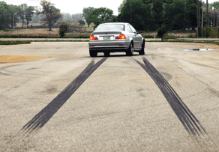
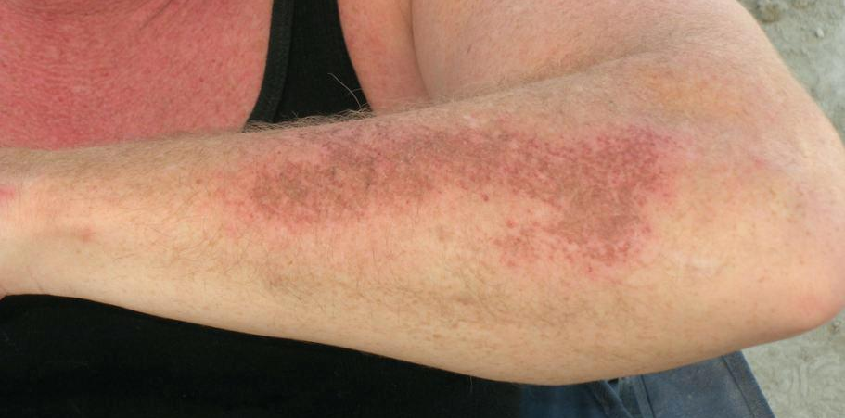
Learning Objectives
CFU
What are the four ways of reducing friction that we are going to learn about?
Identify and explain ways of reducing friction, including:
Lubrication Rollers / balls | Levitation Streamlining
Activate Prior Knowledge
Friction is a force that resists movement between two objects that are touching. It is a contact force.
Think, Pair, Share:
write down three examples of when friction is a good thing.
write down three examples of when friction is a bad thing.

Slide 6

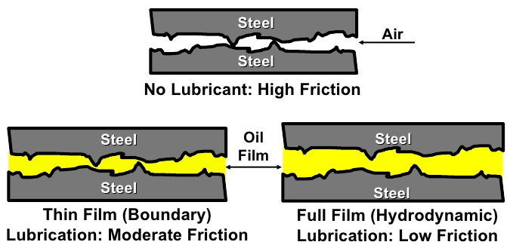
Concept Development
CFU 1
How does lubrication reduce friction?
Reducing Friction
Since friction is often unhelpful, it can be useful to reduce the amount of friction between objects. This can be done in many different ways.
Lubrication
Using a lubricant such as oil or grease reduces friction by making surfaces slippery.
CFU 2
Where else might you use a lubricant to reduce friction?
Vocabulary
lubrication (noun) a means of reducing friction by making surfaces slippery

Slide 7
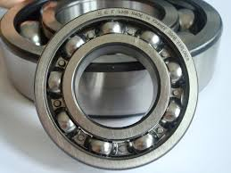
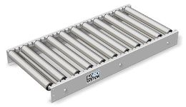
Concept Development
CFU 1
Why is using rollers or balls an effective way of reducing friction?
Reducing Friction
Since friction is often unhelpful, it can be useful to reduce the amount of friction between objects. This can be done in many different ways.
Rollers or balls
Rollers and balls roll along surfaces, which produces much less friction than sliding or dragging.
CFU 2
Where else might you use rollers or balls to reduce friction?
Vocabulary
lubrication (noun) a means of reducing friction by making surfaces slippery

Slide 8
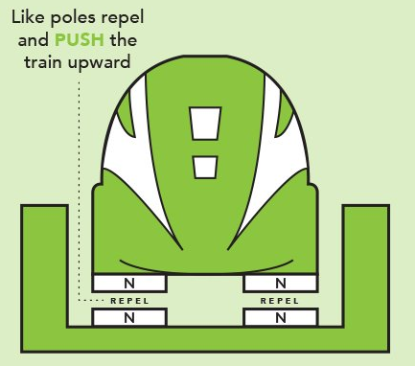
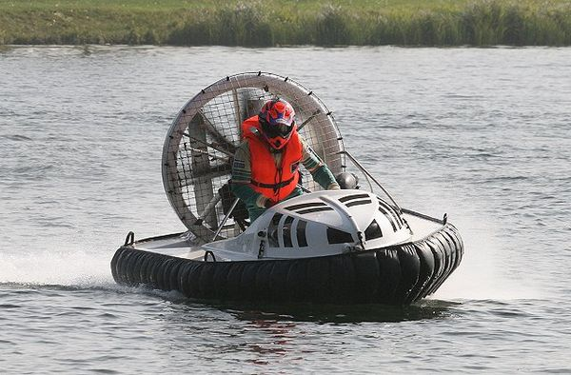
Concept Development
CFU 1
How does levitation reduce friction?
Reducing Friction
Since friction is often unhelpful, it can be useful to reduce the amount of friction between objects. This can be done in many different ways.
Levitation
Levitation reduces or removes contact between two surfaces, which reduces or removes friction.
CFU 2
Where else might you use levitation to reduce friction?
Vocabulary
lubrication (noun) a way to reduce friction by making surfaces slippery levitation (noun) a way to reduce friction by minimising contact between surfaces

Slide 9
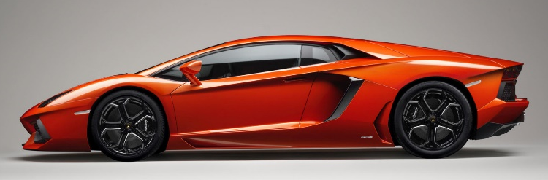
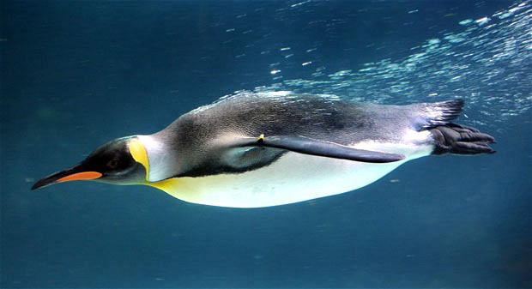
Concept Development
CFU 1
What does streamlined mean?
Reducing Friction
Since friction is often unhelpful, it can be useful to reduce the amount of friction between objects. This can be done in many different ways.
Streamlining
Making an object streamlined (smooth and rounded) helps decrease friction between an object and the air (or water).
CFU 2
What is another example of streamlining?
Vocabulary
lubrication (noun) a way to reduce friction by making surfaces slippery levitation (noun) a way to reduce friction by minimising contact between surfaces streamlining (noun) a way to reduce friction by making an object smooth and rounded

Slide 10
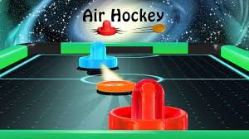
Skill Development / Guided Practice
CFU 1
Which method of friction reduction is being used?
In situations where friction is reduced, you need to:
Identify which method is being used.
Explain how friction is being reduced in that situation.
This is an example of levitation. The air pushes the puck up, reducing its contact with the table.
CFU 2
How does this method work in this situation?
Reminders:
Lubrication makes things slippery Balls and rollers make things roll, which produces less friction than pushing or sliding Levitation reduces contact between surface Streamlined objects are smooth and rounded

Slide 11

Skill Development / Guided Practice
CFU 1
Which method of friction reduction is being used?
In situations where friction is reduced, you need to:
Identify which method is being used.
Explain how friction is being reduced in that situation.
This is an example of lubrication. The oil coats the metal, making it slippery.
CFU 2
How does this method work in this situation?
Reminders:
Lubrication makes things slippery Balls and rollers make things roll, which produces less friction than pushing or sliding Levitation reduces contact between surface Streamlined objects are smooth and rounded

Slide 12
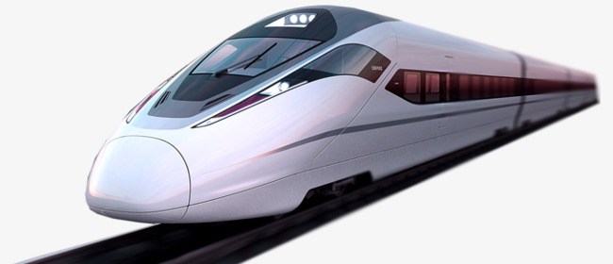
Skill Development / Guided Practice
CFU 1
Which method of friction reduction is being used?
In situations where friction is reduced, you need to:
Identify which method is being used.
Explain how friction is being reduced in that situation.
This is an example of streamlining. The train is smooth and rounded, reducing friction between it and the air.
CFU 2
How does this method work in this situation?
Reminders:
Lubrication makes things slippery Balls and rollers make things roll, which produces less friction than pushing or sliding Levitation reduces contact between surface Streamlined objects are smooth and rounded

Slide 13
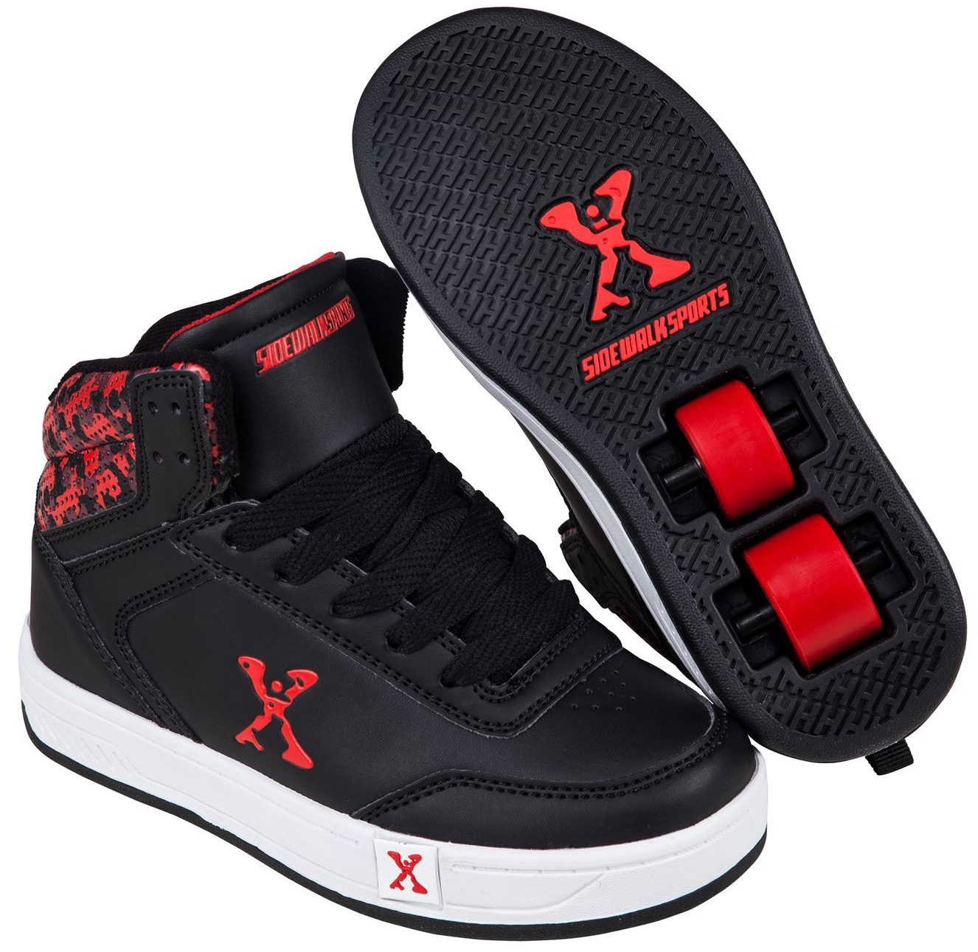
Skill Development / Guided Practice
CFU 1
Which method of friction reduction is being used?
In situations where friction is reduced, you need to:
Identify which method is being used.
Explain how friction is being reduced in that situation.
This is an example of a roller. The wheels in the shoes roll, which produces less friction than pushing or sliding.
CFU 2
How does this method work in this situation?
Reminders:
Lubrication makes things slippery Balls and rollers make things roll, which produces less friction than pushing or sliding Levitation reduces contact between surface Streamlined objects are smooth and rounded

Slide 14

Relevance
Knowing about forces helps you to understand the world around you.
Reducing friction is important to all sorts of people: engineers, car mechanics, athletes, fashion designers, astronauts…

Slide 15
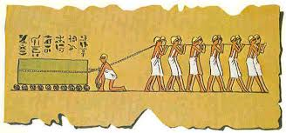
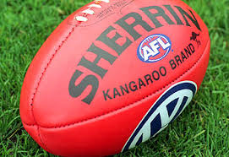
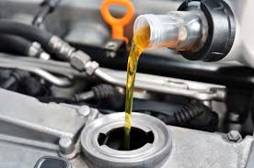
Skill Closure
Describe the method of reducing friction shown in each picture.
1.
2.
3.
4.

Slide 16
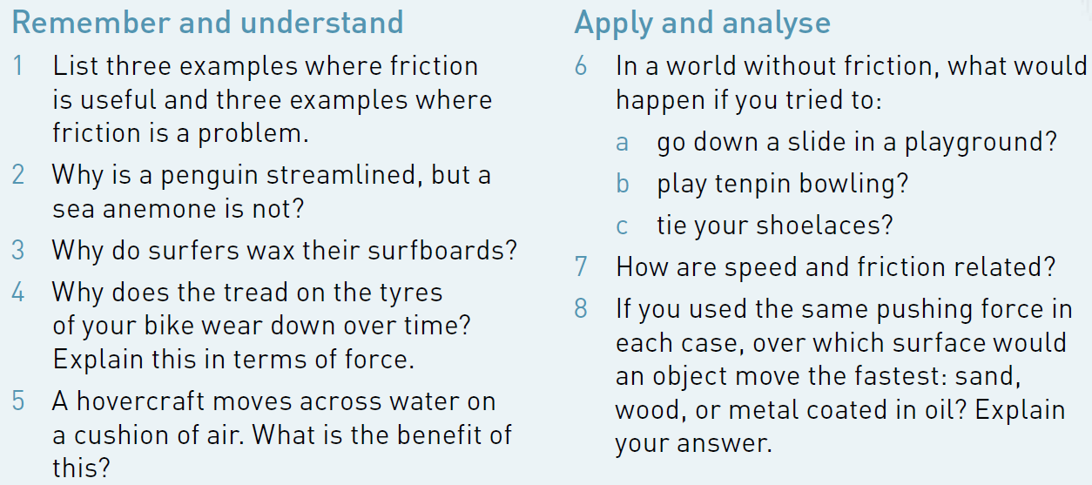
Independent Practice
Complete Qs 1-8 on p. 131 of your textbook.
Reminders:
Lubrication makes things slippery Balls and rollers make things roll, which produces less friction than pushing or sliding Levitation reduces contact between surface Streamlined objects are smooth and rounded

